Slide 1
Deepl translate
The world’s most accurate translator

Slide 2
The Deepl website – created by jaroslaw kutylowski

Slide 3
Deepl vs OTHER LEADING ONLINE TRANSLATORS

Slide 4
How DOES dEEPl work?

Slide 5
NMT AND TRANSFORMER
Neural Machine Translation
Based on a Transformer
Instantaneously transforms one kind of input into another
Helps the translator to identify sophisticated linguistic patterns
Can recognise relationships between words in a comprehensive way.

Slide 6
Global linguistic flexibility

Slide 7
MASTERING LINGUISTIC NUANCES
Effectively translates idiomatic expressions and colloquialisms.

Slide 8
Efficiency at your fingertips

Slide 9
unlocking premium features with
Translate longer texts
Faster translation speed
Access to DeepL AI
Starter plan €7.49

Slide 10
How to use deepl
Open web browser and search for the DeepL website https://www.deepl.com/translator

Slide 11
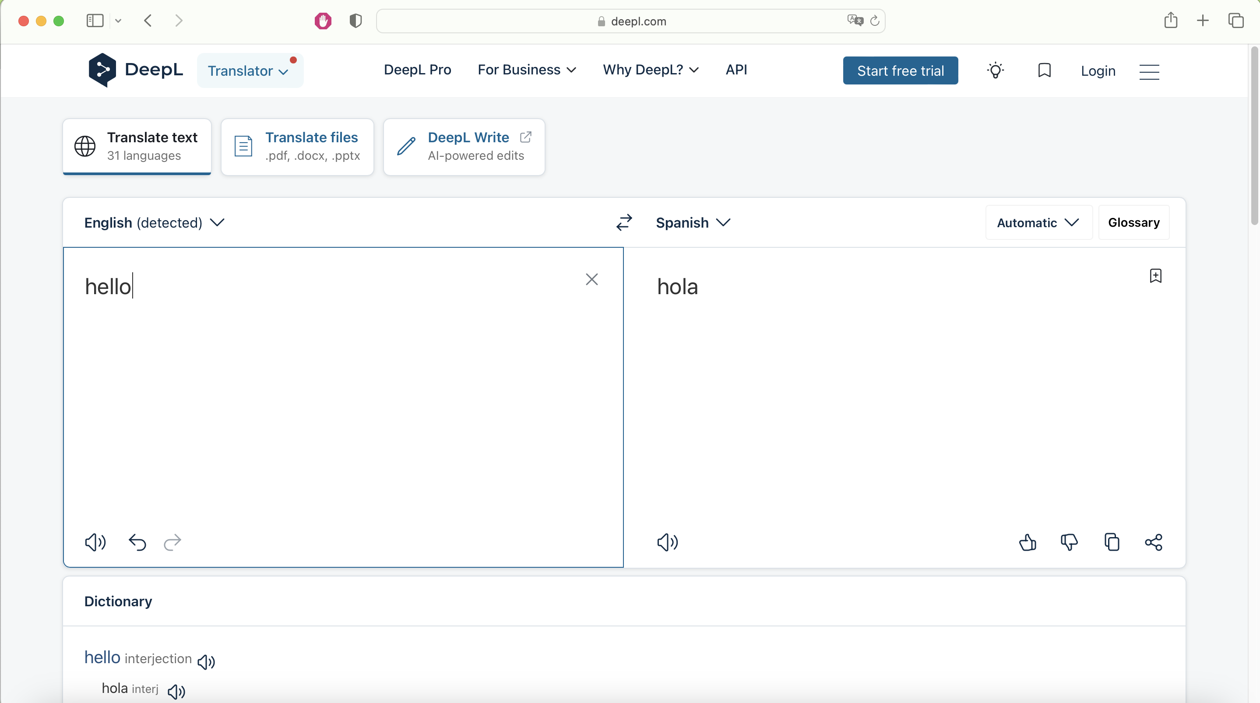
Click arrow to choose target language
Input text you would like to translate here
Translation will instantly appear here!

Slide 12
Upload files for translation here
Share text
Listen to pronunciation of word
See dictionary section here
Copy text

Slide 13
What about businesses using deepl? a real-world application for business translation
Business inputs documentation.
System uses its neural network to process text.
No need for hours of sitting at a desk for hours manually translating.
DeepL produces the text in target language.
Data is safely secure and private.
Saves time 🕐 and money 💰!

Slide 14
To sum it all up…
Advanced neural network
Translation Quality
Language Options
Simplicity
Availability of DeepL Pro

